Slide 1
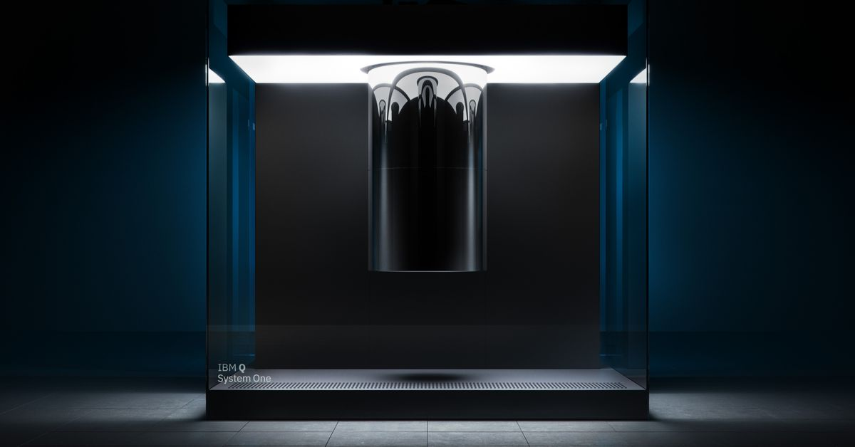
How Did We Do?
Brief overview of performance against each objective.
Transmon Qubit
Jechiel van Dijk

Slide 2
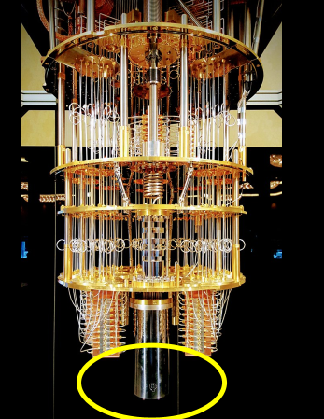
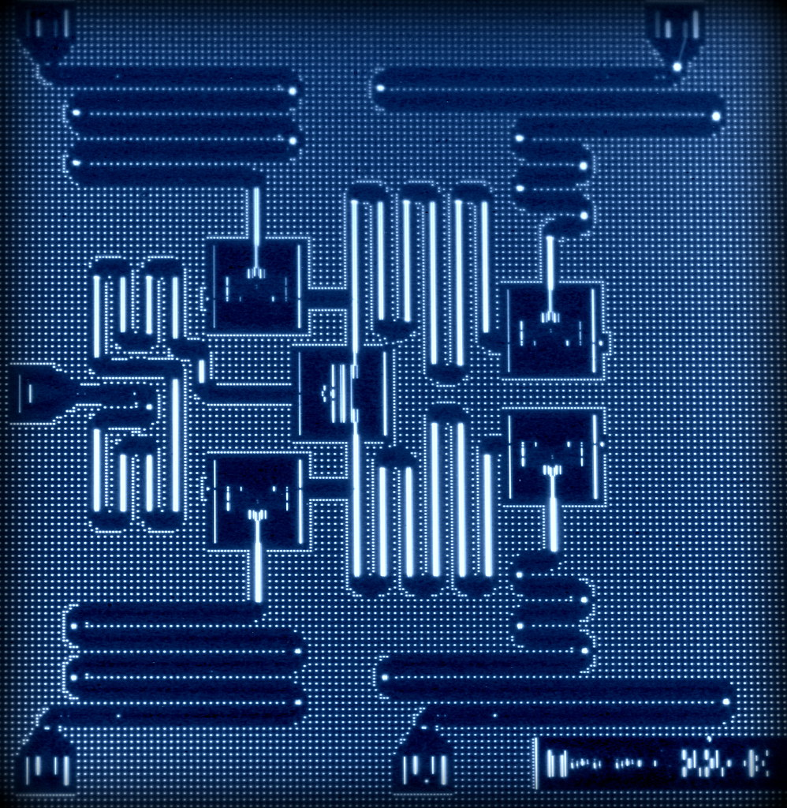

Slide 3
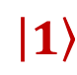
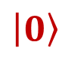
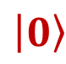
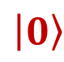
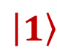
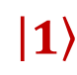
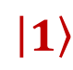
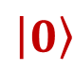
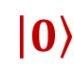

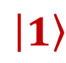
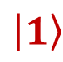
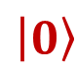
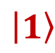
When do we have a quantum computer
Communication between Qubits :
2 States:
Control the States:
Hey darling,
Wanna get entangled
$$\left|1\right\rangle$$
$$\left|1\right\rangle$$
$$\left|1\right\rangle$$
$$\left|1\right\rangle$$
$$\left|0\right\rangle$$
$$\left|0\right\rangle$$
$$\left|0\right\rangle$$
$$\left|0\right\rangle$$
Read out:
Decoherent time:
$$\left|1\right\rangle$$
$$\left|1\right\rangle$$
$$\left|1\right\rangle$$
$$\left|0\right\rangle$$
$$\left|0\right\rangle$$
$$\left|0\right\rangle$$

Slide 4
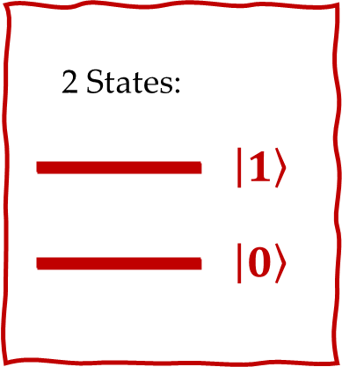
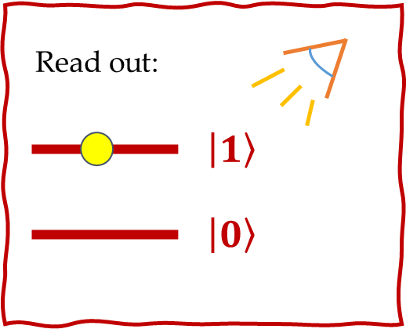
Overview
The Transmon qubit is part of a circuit
Find the Hamiltonian of the Circuit.
Read out the state of the qubit
V
Circuit with 1 qubit
Frequency in
Frequency out
“Frequency out” depends on the state of the qubit

Slide 5
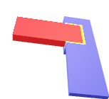
The Game Plan
Superconductors
Quantum Harmonic Oscillator / LC circuit / resonator
QHO vs. Cooper pair Box (Spoiler alert: Josephson junction)
Josephson Junction
Anatomy
Equations
Cooper pair Box
Transmon
Notes:
Reason of 3. is that mathematically we talk about QHO, physically: it is a LC circuit and the function is a resonator

Slide 6
Superconductors
Superconductors
Superconductors
Quantum Harmonic Oscillator / LC circuit / resonator
QHO vs. Cooper pair Box (Spoiler alert: Josephson junction)
Josephson Junction
Anatomy
Equations
Cooper pair Box
Transmon
1

Slide 7
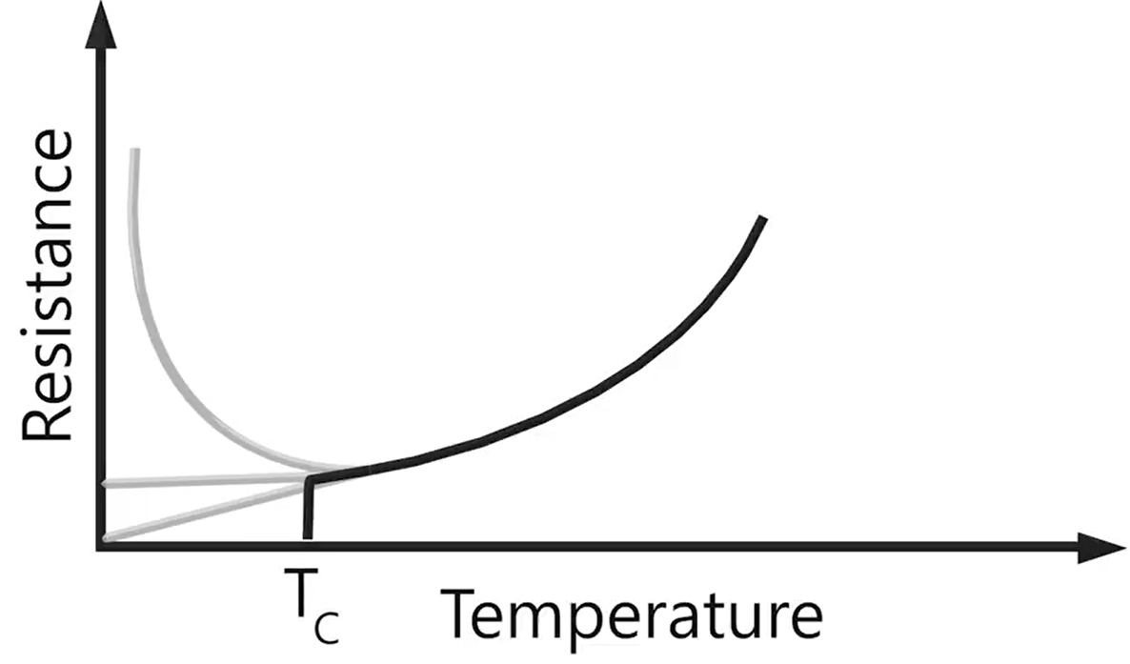
Superconductivity
Superconductors
There is no resistance for electrons in a superconductor below T_{c} (critical temperature)
Electrons will form Cooper pairs
Cooper pairs act like bosons

Slide 8
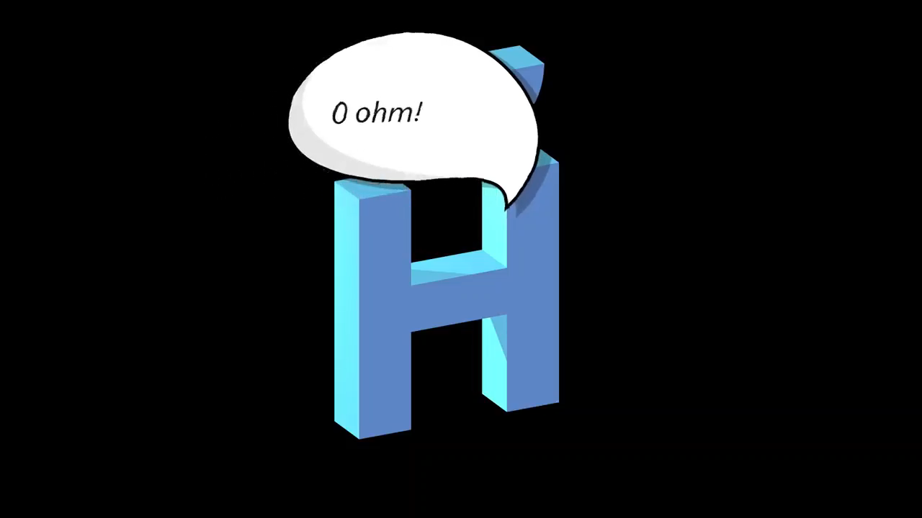
Superconductivity
Superconductors
Video by Higgsino physics (youtube)

Slide 9
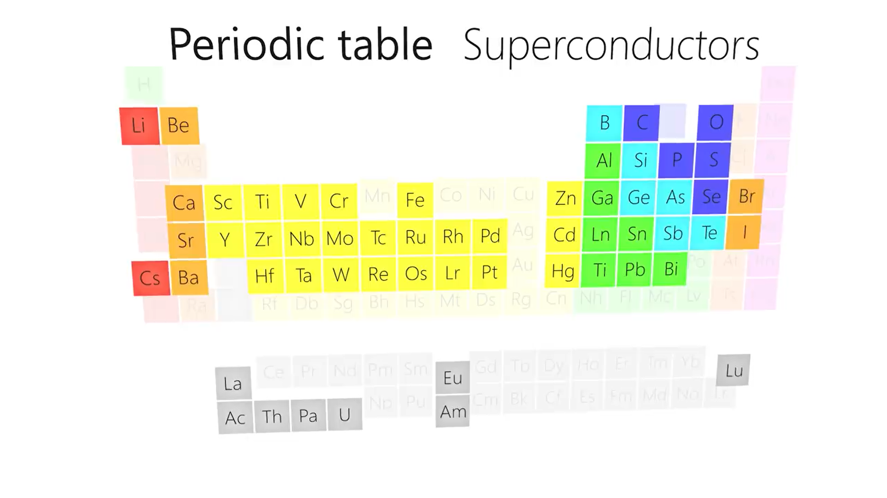
Superconductors
By Higgsino physics (youtube)

Slide 10
LC circuit
LC circuit
Superconductors
Quantum Harmonic Oscillator / LC circuit / resonator
QHO vs. Cooper pair Box (Spoiler alert: Josephson junction)
Josephson Junction
Anatomy
Equations
Cooper pair Box
Transmon
2

Slide 11
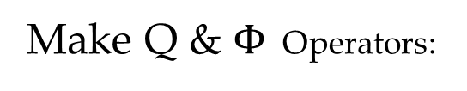
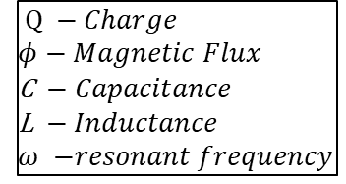
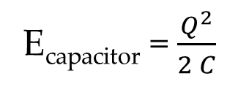
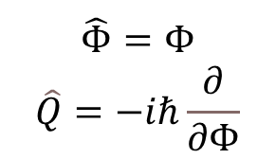
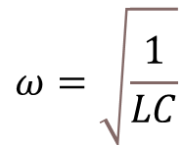
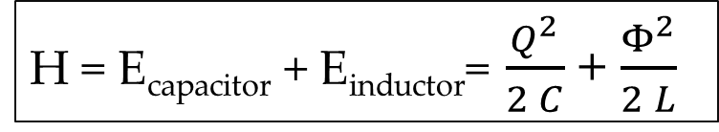
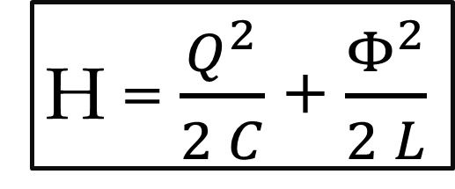
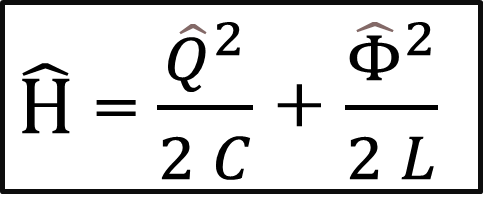
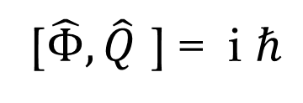
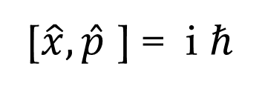
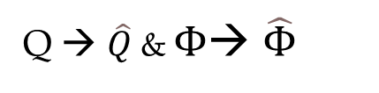
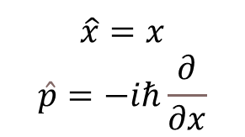
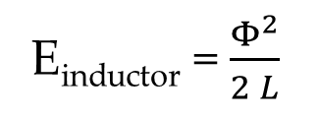
LC circuit
LC circuit
$Q −Charge$
$φ$ $− Magnetic Flux$
C $− Capacitance$
L $− Inductance$
$ω$ $−resonant frequency$
E_{capacitor} = $\frac{Q^{2}}{2 C}$
E_{inductor} = $\frac{Φ^{2}}{2 L}$
$$ω=\sqrt{\frac{1}{LC}}$$
H = E_{capacitor} + E_{inductor}= $\frac{Q^{2}}{2 C}$ + $\frac{Φ^{2}}{2 L}$
Quantize charge and flux
Make Q & $Φ$ Operators:
Q → $\hat{Q}$ & $Φ$→ $\hat{Φ}$
$$\hat{Φ}=Φ$$
$$\hat{Q}=−iℏ\frac{∂}{∂Φ}$$
H = $\frac{Q^{2}}{2 C}$ + $\frac{Φ^{2}}{2 L}$
$\hat{H}$ = $\frac{{\hat{Q}}^{2}}{2 C}$ + $\frac{{\hat{Φ}}^{2}}{2 L}$
[$\hat{Φ},\hat{Q}$] = i $ℏ$
$$\hat{x}=x$$
$$\hat{p}=−iℏ\frac{∂}{∂x}$$
[$\hat{x},\hat{p}$] = i $ℏ$

Slide 12
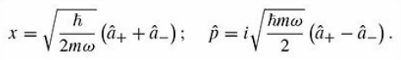
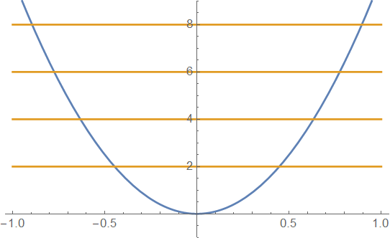
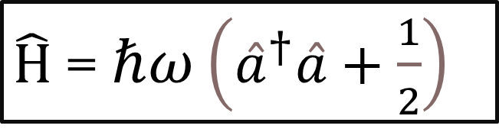
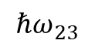
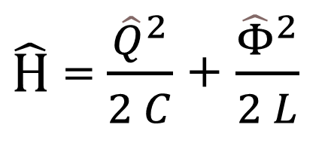
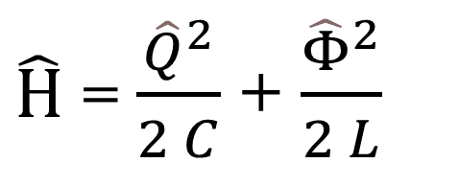
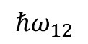
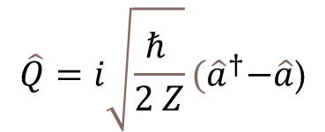
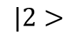
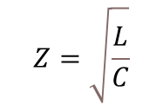
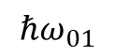
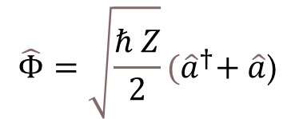
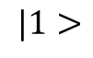
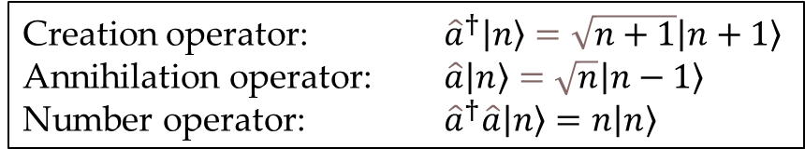
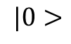
LC circuit
$\hat{H}$ = $\frac{{\hat{Q}}^{2}}{2 C}$ + $\frac{{\hat{Φ}}^{2}}{2 L}$
Creation operator: ${\hat{a}}^{†}\left|n\right\rangle =\sqrt{n+1}\left|n+1\right\rangle$
Annihilation operator: $\hat{a}\left|n\right\rangle =\sqrt{n}\left|n−1\right\rangle$
Number operator: ${\hat{a}}^{†}\hat{a}\left|n\right\rangle =n\left|n\right\rangle$
$$Z=\sqrt{\frac{L}{C}}$$
$$ℏω_{23}$$
$$\hat{Φ}=\sqrt{\frac{ℏ Z}{2}}{(\hat{a}}^{†}+ \hat{a}\text{)}$$
$$\hat{Q}=i\sqrt{\frac{ℏ }{2 Z}}{(\hat{a}}^{†}−\hat{a}\text{)}$$
$$|2>$$
$$ℏω_{12}$$
$$|1>$$
$$ℏω_{01}$$
$$|0>$$
$\hat{H}$ = $\frac{{\hat{Q}}^{2}}{2 C}$ + $\frac{{\hat{Φ}}^{2}}{2 L}$
$\hat{H}$ = $ℏω\left({\hat{a}}^{†}\hat{a}+\frac{1}{2}\right)$
Notes:
We will be using both forms later on

Slide 13
From QHO to CPB
Cooper pair Box
3
- Josephson Junction
Josephson junction is a non-linear inductor
Superconductors
Quantum Harmonic Oscillator / LC circuit / resonator
QHO vs. Cooper pair Box (Spoiler alert: Josephson junction)
Josephson Junction
Anatomy
Equations
Cooper pair Box
Transmon

Slide 14
















Harmonic Oscillator
Cooper pair Box
Anharmonic Oscillator
$$ℏω_{23}$$
$$|2>$$
$$|2>$$
$$ℏω_{23}$$
$$ℏω_{12}$$
$$ℏω_{12}$$
$$|1>$$
$$|1>$$
$$ℏω_{01}$$
$$ℏω_{01}$$
$$|0>$$
$$|0>$$
$$ℏω_{01}=ℏω_{12}=ℏω_{23}$$
$$ℏω_{01}≠ℏω_{12}≠ℏω_{23}$$
So we can constrict ourselves to the 2 energy levels: $\left|0\right\rangle \& \left|1\right\rangle$

Slide 15

Josephson Junction
JJ Anatomy
4
Anatomy
Cooper pairs
Equation
Superconductors
Quantum Harmonic Oscillator / LC circuit / resonator
QHO vs. Cooper pair Box (Spoiler alert: Josephson junction)
Josephson Junction
Anatomy
Equations
Cooper pair Box
Transmon

Slide 16


Slide 17

JJ Anatomy

Slide 18

Josephson Junction
JJ Anatomy
Superconductor
Insulator
Superconductor

Slide 19
JJ Anatomy
Superconductor
Insulator
Superconductor

Slide 20




Cooper pairs
Cooper pairs
Spin = 0
Spin = $±\frac{1}{2}$
e
e
electron
e
Quantum tunnels through
Below critical temperature
Notes:
Spin in some type of superconductors can be -1 or 1

Slide 21



Energy of Josephson
JJ Equations
$$I(Φ)$$
V = something * $\frac{dI}{dt}$
E_{Josephson}
$$E=P=\int{V}I dt$$
Josephson current

Slide 22




Josephson equations
JJ Equations
$$I_{s}=I_{c}\sin\left(\frac{2πΦ}{Φ_{0}}\right)$$
$$\frac{∂\hat{φ}}{∂t}=\frac{2 eV}{ℏ}$$
$$Φ_{0}=\frac{h}{2e}$$
$I_{s }$= current in the junction
$I_{c}$ = Maximum current of the Junction in a zero-voltage state
$\hat{φ}$= phase difference between the 2 superconductors

Slide 23






Josephson Energy
JJ Equations
$$E=P=\int{V}I dt$$
$$E=−E_{j}\cos{\frac{2πΦ}{Φ_{0}}}$$
$$I=I_{0}\sin{\frac{2πΦ}{Φ_{o}}}$$
$$E_{j}=\frac{I_{0}Φ_{0}}{2π}$$
$$E=\int{\frac{dΦ}{dt}I_{0}\sin{\frac{2πΦ}{Φ_{0}}}} dt$$
$$V=\frac{dΦ}{dt}$$

Slide 24







Josephson Inductance
JJ Equations
Just to show the non-linearity
$$I=I_{0}\sin{\frac{2πΦ}{Φ_{o}}}$$
$$L=\frac{Φ_{0}}{I_{0}2π}\frac{1}{\cos{\frac{2πΦ}{Φ_{o}}}}$$
$$\frac{dI}{dt}=\frac{I_{0}2π}{Φ_{0}}\cos{(\frac{2πΦ}{Φ_{o}}})\frac{dΦ}{dt}$$
$$L$$
$$\frac{dΦ}{dt}=V$$
$$V=L\frac{dI}{dt}$$
$$V=\frac{Φ_{0}}{I_{0}2π}\frac{1}{\cos{\frac{2πΦ}{Φ_{o}}}}\frac{dI}{dt}$$
Solve for V

Slide 25
Cooper pair box
Cooper pair Box
Superconductors
Quantum Harmonic Oscillator / LC circuit / resonator
QHO vs. Cooper pair Box (Spoiler alert: Josephson junction)
Josephson Junction
Anatomy
Equations
Cooper pair Box
Transmon
5
Back to the

Slide 26










LC circuit
Cooper pair Box
$\hat{H}$ = E_{capacitor} + E_{inductor} = $\frac{{\hat{Q}}^{2}}{2 C}$ + $\frac{{\hat{Φ}}^{2}}{2 L}$
JC circuit
$\hat{H}$ = E_{capacitor} + E_{Josephson}= $\frac{{\hat{Q}}^{2}}{2 C}$ $−E_{j}\cos{\frac{2π\hat{Φ}}{Φ_{0}}}$
$$\hat{φ}=\frac{2π\hat{Φ}}{Φ_{0}}$$
$$\hat{Q}=2e \hat{n}$$
$\hat{n}−$number of electrons
$\hat{H}$ = $\frac{{(2e)}^{2}}{2 C}{(\hat{n})}^{2}−E_{j}\cos{\hat{φ}}$
$\hat{φ}−$ Phase across the junction
$$E_{j}=\frac{I_{0}Φ_{0}}{2π}$$
$$E_{C}=\frac{e^{2}}{2C}$$
$\hat{H}$ =$4E_{C}{\hat{n} }^{2}−E_{j}\cos{\hat{φ}}$

Slide 27








Cooper pair Box
$\hat{H}$ =$4E_{C}{\hat{n}}^{2}−E_{j}\cos{\hat{φ}}$
$$E_{j}=\frac{I_{0}Φ_{0}}{2π}$$
Vg
$\hat{H}$ =$4E_{C}{(\hat{n}−n_{g})}^{2}−E_{j}\cos{\hat{φ}}$
$$\frac{E_{j}}{E_{C}}$$
$$E_{C}=\frac{e^{2}}{2(C_{g}+C_{J})}$$
$\frac{E_{j}}{E_{C}}=$ 50
$$n_{g}≡\frac{C_{g}V_{g}}{2e}$$
$$n_{g}$$

Slide 28
Transmon
Superconductors
Quantum Harmonic Oscillator / LC circuit / resonator
QHO vs. Cooper pair Box (Spoiler alert: Josephson junction)
Josephson Junction
Anatomy
Equations
Cooper pair Box
Transmon
6
Transmon
1
CPB
Transmon
2
Readout the Transmon

Slide 29








Transmon
$$|2⟩$$
$$E_{c}$$
$$\sqrt{8E_{c}E_{j}}−2E_{c}$$
$$|1⟩$$
$$\sqrt{8E_{c}E_{j}}−E_{c}$$
$$|0⟩$$
https://arxiv.org/pdf/cond-mat/0703002.pdf

Slide 30
Bit of a review

Slide 31




Transmon
Josephson junction
e
$$I_{s}=I_{0}\sin\left(\frac{2πΦ}{Φ_{0}}\right)$$
e
$\hat{H}$ = E_{capacitor} + E_{Josephson}
Vg
$\hat{H}$ =$4E_{C}{(\hat{n}−n_{g})}^{2}−E_{j}\cos{\hat{φ}}$
$\frac{E_{j}}{E_{C}}=$ 50

Slide 32
Next
Transmon
Input
output
Vg

Slide 33
Coplanar waveguide resonator LC circuit
Transmon
Insulator
Superconductor
This is a LC circuit
Resonant frequency
Vg

Slide 34
Transmon
Input
output

Slide 35


Hamiltonian
Input
output
$\hat{H}$ = $\hat{H}$_{resonator} + $\hat{H}$_{qubit}
$$\hat{H}=\left(\frac{{\hat{Q}}_{r}^{2}}{2C_{r}}+\frac{{\hat{Φ}}_{γ}^{2}}{2L_{γ}}\right)+\left(4E_{c}{\hat{n}}^{2}+E_{J}\cos{\hat{φ}}\right)$$

Slide 36







Transmon
$$\hat{H}=\left(\frac{{\hat{Q}}_{r}^{2}}{2C_{r}}+\frac{{\hat{Φ}}_{γ}^{2}}{2L_{γ}}\right)+\left(4E_{c}{\hat{n}}^{2}+E_{J}\cos{\hat{ϕ}}\right)$$
Adding the coupling
=$\left(\frac{{\hat{Q}}_{r}^{2}}{2C_{r}}+\frac{{\hat{Φ}}_{γ}^{2}}{2L_{r}}\right)+\left(4E_{c}{\left[\hat{n}−{\hat{n}}_{r}\right]}^{2}−E_{J}\cos{\hat{ϕ}}\right)$
As function of the
Creation and Annihilation
operators
$$=ω_{r}{\hat{a}}^{†}\hat{a}+\left(ω_{01}{\hat{b}}^{†}\hat{b}−\frac{E_{c}}{2}{\hat{b}}^{†}{\hat{b}}^{†}\hat{b}\hat{b}\right)−g\left({\hat{a}}^{†}−\hat{a}\right)\left({\hat{b}}^{†}−\hat{b}\right)$$
Approximate to 2 levels*
$${=ω}_{r}{\hat{a}}^{†}\hat{a}+\frac{1}{2}ω_{01}{\hat{σ}}_{z}−g\left({\hat{a}}^{†}−\hat{a}\right)\left({\hat{σ}}_{+}−{\hat{σ}}_{−}\right)$$
Rotating wave approximation
$${=ω}_{r}{\hat{a}}^{†}\hat{a}+\frac{1}{2}ω_{01}{\hat{σ}}_{z}−g\left({\hat{a}}^{†}{\hat{σ}}_{−}−\hat{a}{\hat{σ}}_{+}\right)$$
Now we look at the situation where:
$$\left|Δ\right|=|ω_{01}−ω_{r}|≫g$$
* $\hat{b}$ and ${\hat{b}}^{†}$ function
as ${\hat{σ}}_{−}$ and ${\hat{σ}}_{+}$ respectively

Slide 37








$${\hat{σ}}_{z}$$
Transmon
Hamiltonian:
Input
output
$$H≈\left(ω_{r}+χ{\hat{σ}}_{z}\right){\hat{a}}^{†}\hat{a}+\frac{ω_{01}}{2}{\hat{σ}}_{z}$$
$${\hat{a}}^{†}\hat{a}$$
Operates on the qubit
+1 for excited state
-1 for excited state
$\left[\begin{matrix}1 & 0 \\ 0 & −1\end{matrix}\right]$
Operates on the resonator
Corresponds to the amount of excitations in the resonator (number operator)
Operators:
$$χ=\frac{g}{Δ}=\frac{g}{ω_{01}−ω_{r}}$$
$ω_{01}$ is the frequency to excite from ground to first state
Constants:
$ω_{r}$ is the resonance frequency of the resonator
$$Δ>g$$

Slide 38






$${\hat{σ}}_{z}$$
Transmon
$$H≈\left(ω_{r}+χ{\hat{σ}}_{z}\right){\hat{a}}^{†}\hat{a}+\frac{ω_{01}}{2}{\hat{σ}}_{z}$$
+1 for excited state
-1 for excited state
$\left(ω_{r}+χ{\hat{σ}}_{z}\right) {\hat{a}}^{†}\hat{a} corresponds to number operator of the resonator$
2$χ$
Qubit in the
ground state
Qubit in the
excited state
Transmission
$$ω_{r}−χ$$
$$ω_{r}$$
$$ω_{r}+χ$$
Frequency

Slide 39

V

Slide 40
Thank you!

